Slide 1
Adding Graphics to a Presentation
Microsoft Powerpoint 2013
Lesson 8

Slide 2
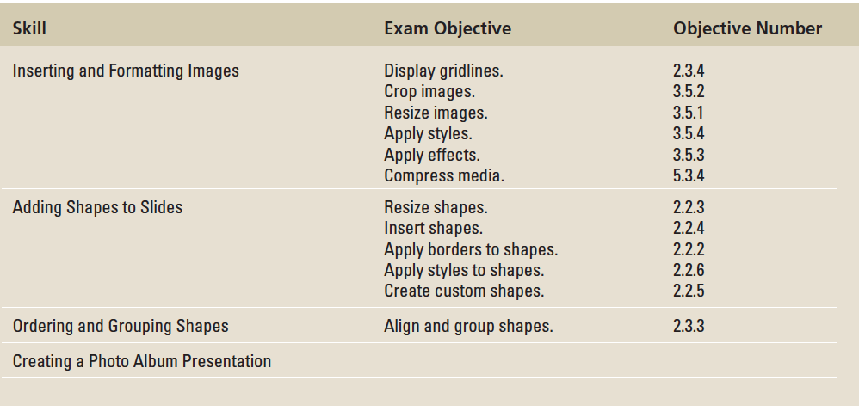
Objectives

Slide 3
Step by Step: Insert an Image from Office.com
GET READY. Before you begin these steps, make sure that your computer is on. Log on, if necessary.
START PowerPoint, if the program is not already running.
Locate and OPEN the Exhibits presentation and save it as Exhibits Final.
Go to slide 4 and click the Online Pictures icon in the empty content placeholder. The Insert Pictures dialog box opens.
Notes:
Another Way: To insert Office.com images on a slide that does not have a content placeholder, click the Online Pictures button on the Insert tab.

Slide 4
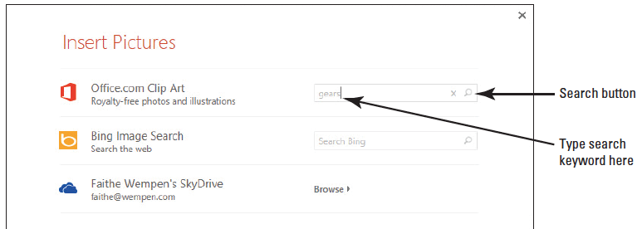
Step by Step: Insert an Image from Office.com
Click in the Office.com Clip Art text box and type gears (see the figure below).
Press Enter, or click the Search icon. PowerPoint searches for images that match the keyword and displays them in the task pane.

Slide 5
Step by Step: Insert an Image from Office.com
Scroll down through the results and click a picture of gears. Choose a photo, rather than a line drawing.
Click Insert. The image is inserted in the content placeholder.
SAVE the presentation.
PAUSE. LEAVE the presentation open to use in the next exercise.

Slide 6
Step by Step: Insert a Picture from a File
You do not have to rely on PowerPoint’s clip art files to illustrate your presentation.
You can download many pictures for free on the Internet or create your own picture files using a digital camera.
USE the Exhibits Final presentation that is still open from the previous exercise.
Go to slide 3 and on the Insert tab, click the Pictures button. The Insert Picture dialog box opens.
Notes:
Another Way: Click the Pictures icon in any content placeholder to open the Insert Picture dialog box.

Slide 7
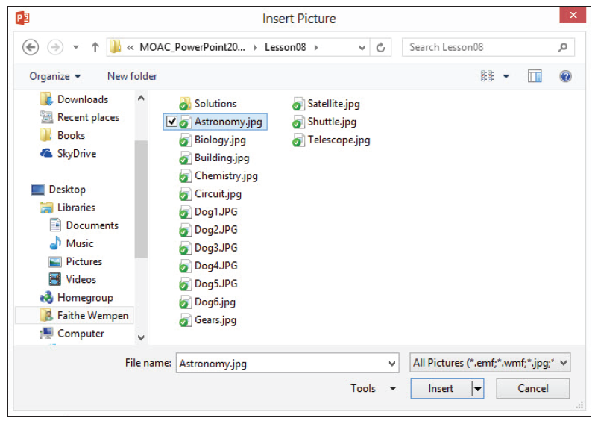
Step by Step: Insert a Picture from a File
Navigate to the location of the data files for this lesson, click Astronomy.jpg (see the fgure below), and then click Insert.

Slide 8
Step by Step: Insert a Picture from a File
The dialog box may look different from the one shown, depending on your Windows version, the view in effect, and the other files in the folder. The picture appears on the slide.
SAVE the presentation.
PAUSE. LEAVE the presentation open to use in the next exercise.

Slide 9
Step by Step: Change a Picture
USE the Exhibits Final presentation that is still open from the previous exercise.
Go to slide 4.
Right-click the picture and click Change Picture…. The Insert Pictures dialog box opens.
Click the Browse hyperlink next to From a file. The Insert Picture dialog box opens. (This is a different dialog box from the one in step 2.)
Navigate to the folder containing the data files for this lesson and click Gears.jpg.

Slide 10
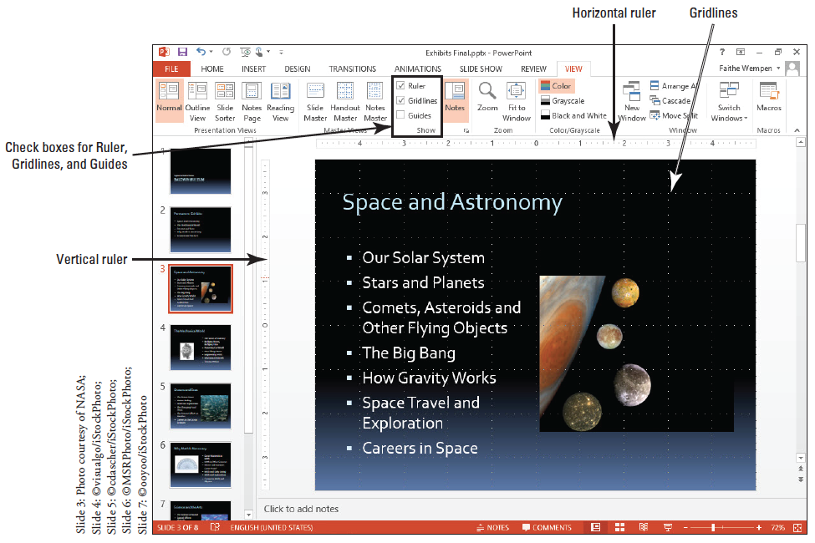
Step by Step: Change a Picture
Click Insert. The picture is replaced (see the figure below).
SAVE the presentation.
PAUSE. LEAVE the presentation open to use in the next exercise.

Slide 11
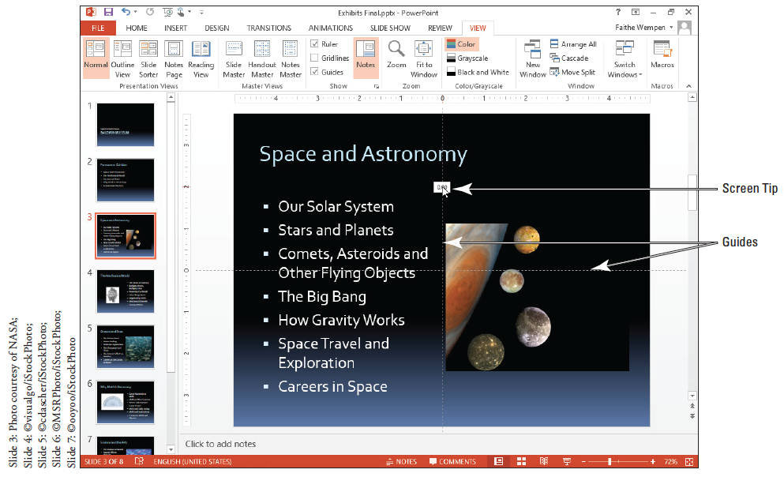
Step by Step: Use the Ruler, Gridlines, and Guides
USE the Exhibits Final presentation that is still open.
Go to slide 3. On the View tab, click Ruler if this option is not already selected. The vertical and horizontal rulers appear in the Slide pane.
Click to mark the Gridlines check box. A grid of regularly spaced dots overlays the slide (see the figure at right).
Notes:
Another Way: Right-click a slide outside of any placeholder, and then click Ruler.

Slide 12
Step by Step: Use the Ruler, Gridlines, and Guides
Click to mark the Guides check box. The default vertical and horizontal drawing guides display, intersecting at the center of the slide.
The guides will be more useful for positioning pictures in this presentation, so you can turn off the gridlines: click the View tab, and click Gridlines in the Show group to remove the check mark and hide the gridlines.
Click the text box on slide 3 that contains the bulleted list to activate it. You will use the text box’s border to help you position guides.
Click the vertical guide. As you hold down the mouse button, a ScreenTip appears that shows the current position of the guide—0.0, indicating the guide is at the 0 inch mark on the horizontal ruler.
Notes:
Another Way: Right-click an empty area of the slide, point to Grid and Guides, and select Guides from the submenu. Or, click the dialog box launcher in the Show group on the View tab to open the Grid and Guides dialog box and then mark or clear the Guides check box. You can also press Alt+F9 to toggle guides on or off.

Slide 13
Step by Step: Use the Ruler, Gridlines, and Guides
Click and drag the guide to the left until it aligns on the left border of the text placeholder. The ScreenTip should read approximately 4.50 with a left-pointing arrow. Release the mouse button to drop the guide at that location.
Click the horizontal guide to the right of the planet picture and drag upward until the ScreenTip reads 1.67 with an upward-pointing arrow. Drop the guide. It should align with the capital letters in the text placeholder.

Slide 14
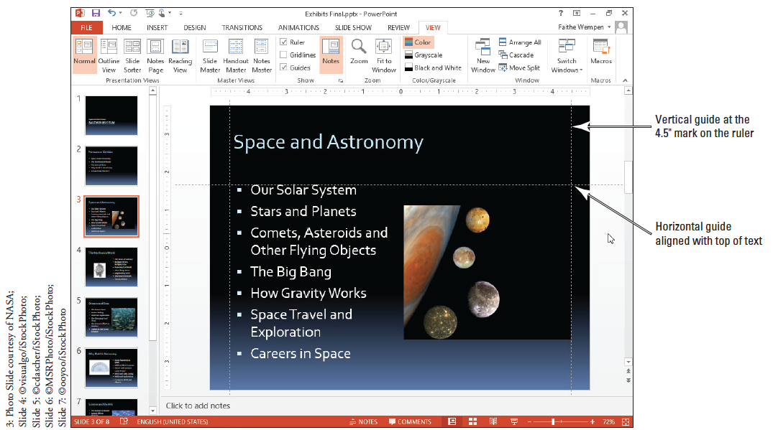
Step by Step: Use the Ruler, Gridlines, and Guides
Click the vertical guide you positioned near the left edge of the slide, hold down Ctrl, and drag a copy of the guide to the right until the ScreenTip reads 4.50 with a right-pointing arrow. Drop the guide by first releasing the mouse button and then the Ctrl key. Your slide should look like the figure below.

Slide 15
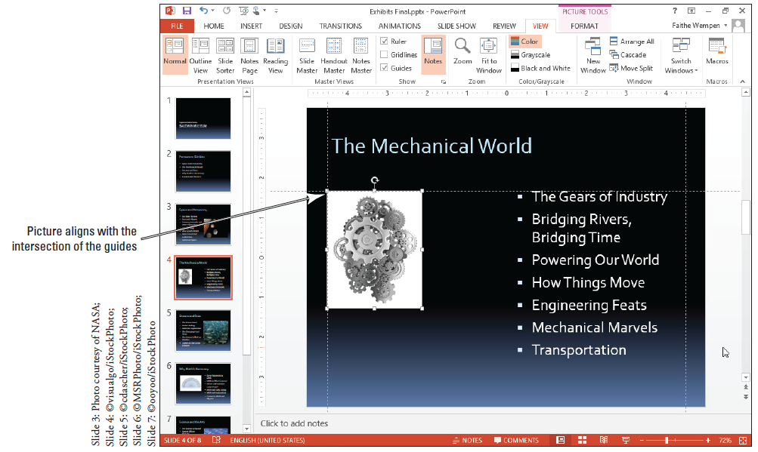
Step by Step: Use the Ruler, Gridlines, and Guides
Go to slide 4, click the gear picture, and drag it until the upper-left corner of the picture snaps to the intersection of the vertical and horizontal guides. Your slide should look like the figure at right.

Slide 16
Step by Step: Use the Ruler, Gridlines, and Guides
Go to slide 5 and drag the picture down and to the left so its upper-right corner snaps to the intersection of the guides.
Go to slide 6 and drag the picture up and to the left to snap to the intersection of the two guides.
On the View tab, clear the Guides check box to turn off the guides.

Slide 17
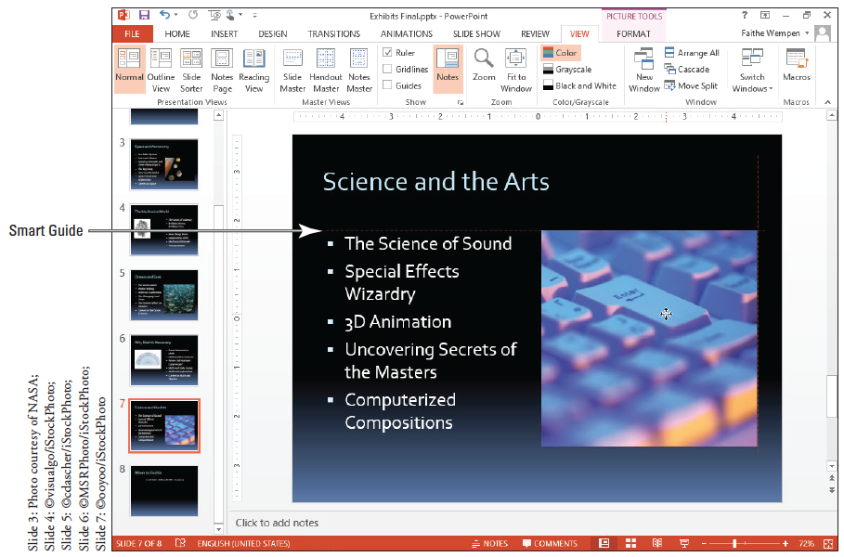
Step by Step: Use the Ruler, Gridlines, and Guides
Go to slide 7 and drag the picture up on the slide until you see a faint red dotted horizontal line at its top. This Smart Guide indicates that the picture is at the same vertical position as the text box to its left (see the figure above). Release the mouse button to drop the picture in the new location.
Notes:
Take Note: If you do not like the Smart Guides feature, you can turn it off. Right-click an empty area of the slide, point to Grid and Guides, and click Smart Guides. Repeat that same procedure to re-enable the feature.

Slide 18
Step by Step: Use the Ruler, Gridlines, and Guides
SAVE the presentation.
PAUSE. LEAVE the presentation open to use in the next exercise.

Slide 19
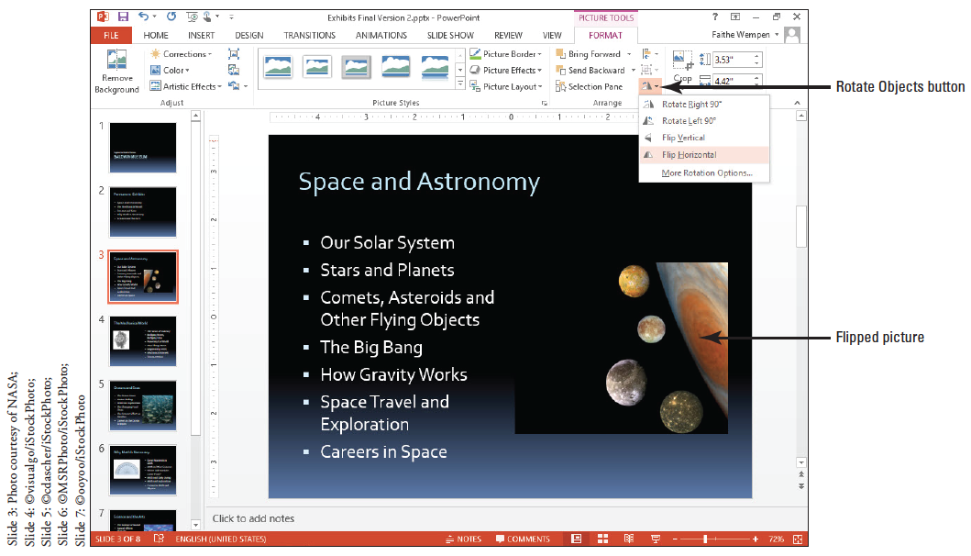
Step by Step: Rotate and Flip an Image
USE the Exhibits Final presentation that is still open. Save the file as Exhibits Final Version 2.
Go to slide 3, and click the picture to select it.
Click the Picture Tools Format tab, click Rotate Objects in the Arrange group, and then click Flip Horizontal in the drop-down menu. The picture reverses its orientation so the planet is on the right and its moons are on the left (see Figure).
Notes:
Another Way: Click the Arrange button on the Home tab, click Rotate, and choose a rotation option.

Slide 20
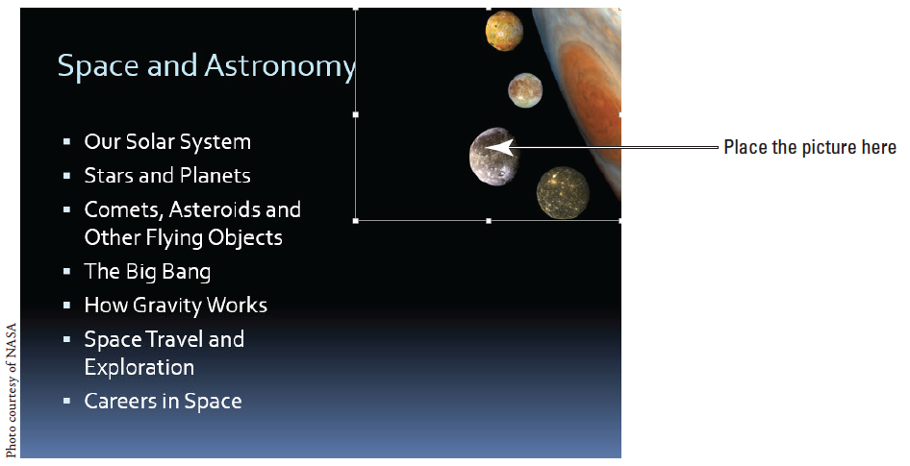
Step by Step: Rotate and Flip an Image
Drag the picture up into the upper-right corner of the slide, so that the top and right edges of the picture align with the top and right edges of the slide (see figure).

Slide 21
Step by Step: Rotate and Flip an Image
Go to slide 4 and click the picture to select it.
Click the Picture Tools Format tab, click Rotate Objects, and then click Rotate Left 90°.
SAVE the presentation.
PAUSE. LEAVE the presentation open to use in the next exercise.

Slide 22
Step by Step: Crop an Image
USE the Exhibits Final Version 2 presentation that is still open from the previous exercise.
Go to slide 6 and click the picture to select it.
Click the Picture Tools Format tab.
Click the Crop button in the Size group. (Click the upper part of the button, not the arrow below it.) The pointer changes to a crop pointer and crop handles appear around the edges of the picture.

Slide 23
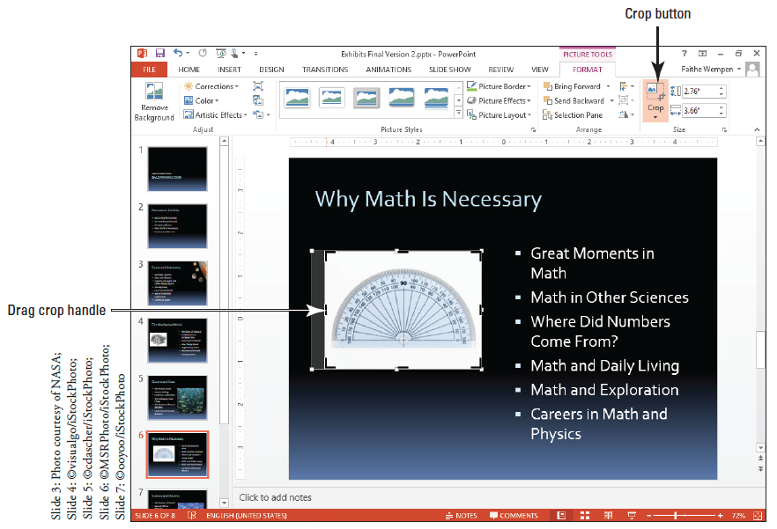
Step by Step: Crop an Image
Click to position the pointer on the left side crop handle and drag inward to crop the picture so that there is an approximately equal amount of white space to the left of the protractor and to the right of it (see figure).

Slide 24
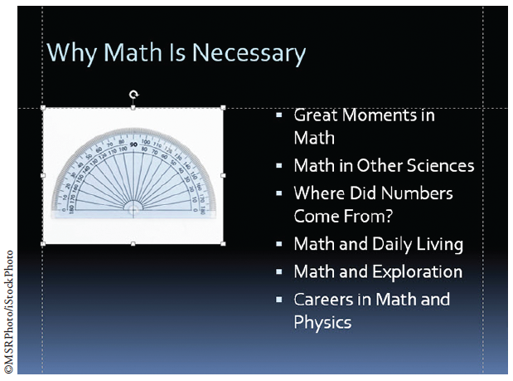
Step by Step: Crop an Image
Release the mouse button, and then click the Crop button again to complete the crop.
On the View tab, mark the Guides check box to turn the guides back on.
Click and drag the cropped picture back up to the intersection of the two guides. Your slide should look similar to the figure at right.

Slide 25
Step by Step: Crop an Image
On the View tab, clear the Guides check box to turn the guides off.
SAVE the presentation.
PAUSE. LEAVE the presentation open to use in the next exercise.

Slide 26
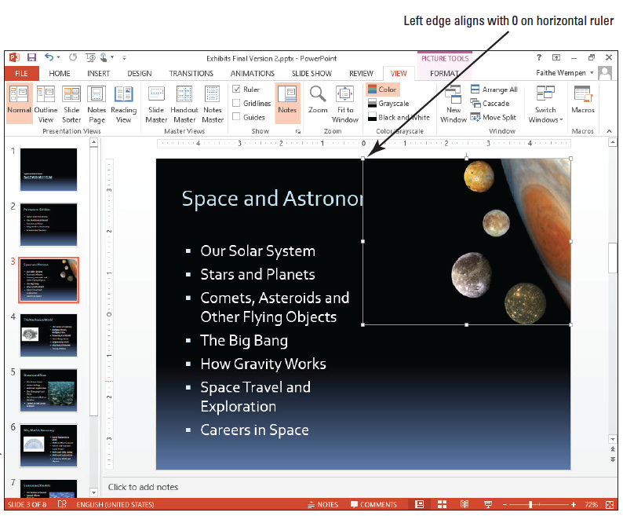
Step by Step: Resize an Image
USE the Exhibits Final Version 2 presentation that is still open from the previous exercise.
Go to slide 3 and click the picture to select it.
Click and drag the lower-left corner of the picture diagonally until the left edge of the picture aligns with the 0 mark on the horizontal ruler (see figure). (Do not worry that the slide title is partially covered; you will fix this problem in a later exercise.)
Notes:
Take Note: If you have difficulty getting the size right because Smart Guides pop up to snap the image into alignment with other objects on the slide, turn off Smart Guides temporarily. Right-click an empty area of the slide, point to Grid and Guides, and click Smart Guides. Repeat that same procedure to re-enable the feature.

Slide 27
Step by Step: Resize an Image
Go to slide 4 and click the picture to select it.
Right-click the picture, and then click Size and Position from the shortcut menu. The Format Picture task pane appears.
Click the Lock aspect ratio check box to deselect this option. You can now specify the height and width independently.
In the Size area of the task pane, click the Reset button to remove previous modifications made to this picture (rotation) from an earlier exercise.
Click the Height up arrow until the height is 3.7 inches. Click the Width up arrow until the width is 3 inches.
Notes:
Another Way: You can open the Format Picture task pane by clicking the dialog box launcher in the Size group on the Picture Tools Format tab.

Slide 28
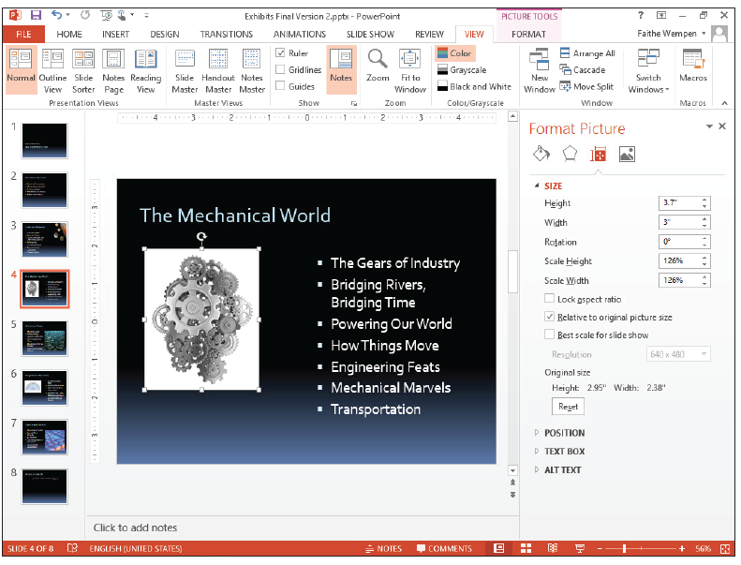
Step by Step: Resize an Image
Click to expand the Position heading in the task pane, and set the Vertical position to 2.1 (see figure). This is an alternate way of moving a picture.
Close the task pane.
Notes:
Another Way: You can also specify a percentage of the original dimensions, instead of an exact size. This is called scaling.

Slide 29
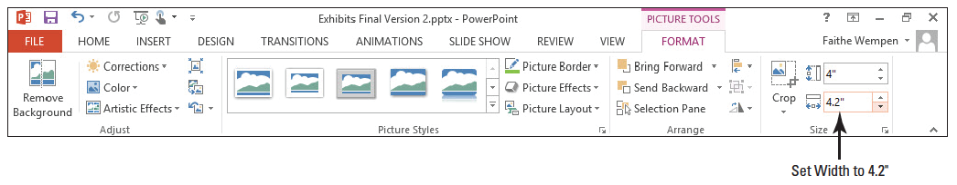
Step by Step: Resize an Image
Go to slide 5 and click the picture to select it.
Click the Picture Tools Format tab, and then click the Width down arrow in the Size group until the picture’s width is 4.2 inches (see figure below).
Turn the guides back on, and then drag the picture to align its upper-right corner with the intersection of the two guides near the right edge of the slide. Then turn the guides off again.

Slide 30
Step by Step: Resize an Image
SAVE the presentation.
PAUSE. LEAVE the presentation open to use in the next exercise.

Slide 31
Step by Step: Apply a Style to a Picture
USE the Exhibits Final Version 2 presentation that is still open from the previous exercise.
Go to slide 5 and click the picture to select it if necessary.
On the Picture Tools Format tab, click the More button in the Picture Styles group. The Picture Styles gallery appears.
Click the Soft Edge Oval style. Your picture should look like the one in the figure on the next slide.

Slide 32
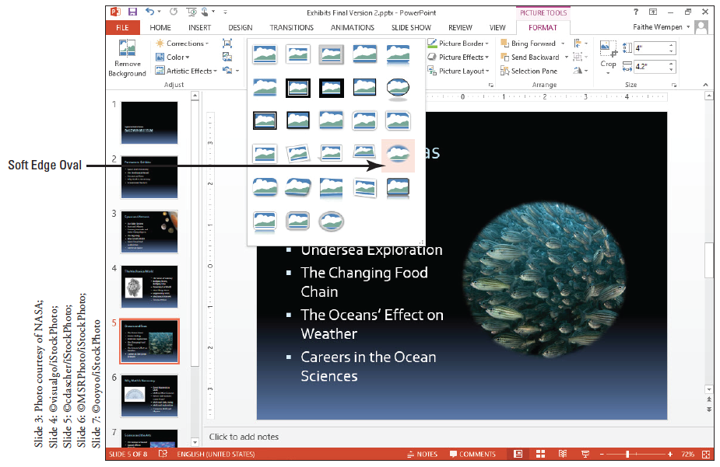
Step by Step: Apply a Style to a Picture

Slide 33
Step by Step: Apply a Style to a Picture
SAVE the presentation.
PAUSE. LEAVE the presentation open to use in the next exercise.
Notes:
Take Note: The style’s picture borders are black or white by default, but you can apply any color to the border using the Picture Border button after applying the style.

Slide 34
Step by Step: Adjust a Picture’s Brightness And Sharpness
USE the Exhibits Final Version 2 presentation that is still open from the previous exercise.
Go to slide 6 and click the picture to select it. This picture is a bit too bright.
Click the Picture Tools Format tab.

Slide 35
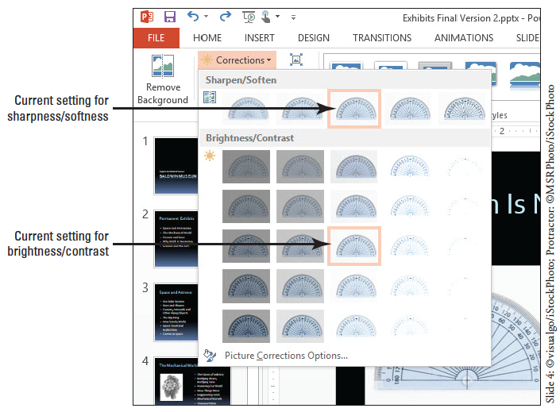
Step by Step: Adjust a Picture’s Brightness And Sharpness
In the Adjust group, click Corrections. A palette of corrections appears (see figure). Notice that there are two sections: Sharpen/ Soften and Bright- ness/Contrast. The center selection in each section is the current setting.

Slide 36
Step by Step: Adjust a Picture’s Brightness And Sharpness
In the Brightness/Contrast section, click the Brightness -20% Contrast; 0% (Normal) setting.
Click the Corrections button again, reopening the menu.
In the Sharpen/Soften section, click Sharpen: 25%.
Click the Corrections button again, and click Picture Corrections Options. The Format Picture task pane opens.

Slide 37
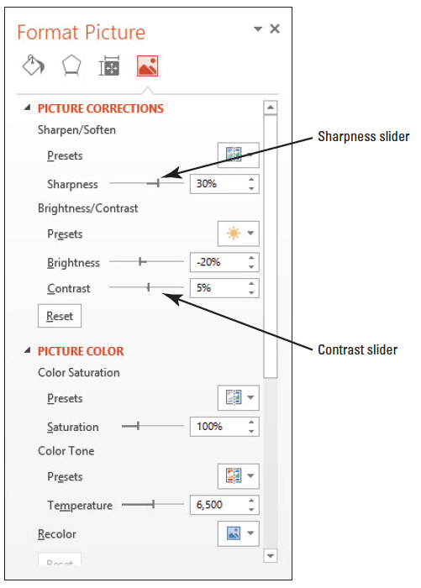
Step by Step: Adjust a Picture’s Brightness And Sharpness
Drag the Sharpness slider to 30% and drag the Contrast slider to 5% (see the figure at right).
Close the task pane.
SAVE the presentation.
PAUSE. LEAVE the presentation open to use in the next exercise.
Notes:
Another Way: You can use the increment arrow buttons to set the values instead of dragging if you find that easier.

Slide 38
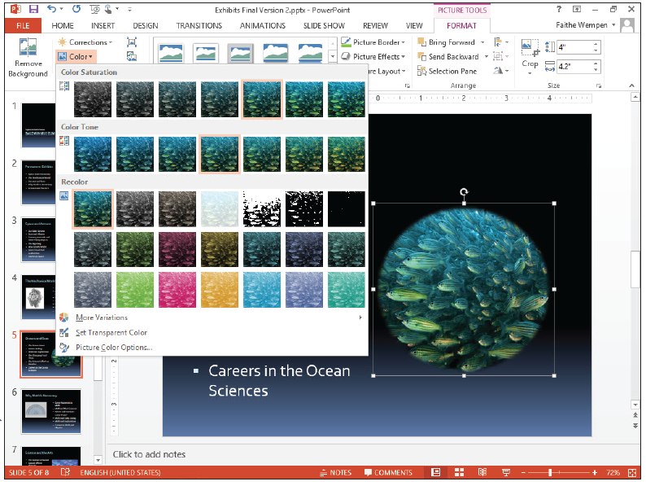
Step by Step: Apply Color Adjustments
USE the Exhibits Final Version 2 presentation that is still open from the previous exercise.
Go to slide 5 and click the picture to select it.
Click the Picture Tools Format tab.
In the Adjust group, click Color. A palette of color choices appears (see figure).

Slide 39
Step by Step: Apply Color Adjustments
In the Color Saturation section, click Saturation 200%.
Click Color again to reopen the palette, point at More Variations, and in the Standard Colors group, point to Light Green to see a preview applied to the picture. Click away from the menu to close the menu without making a selection.
Click Color again to reopen the palette, and click Picture Color Options…. The Format Picture task pane opens.

Slide 40
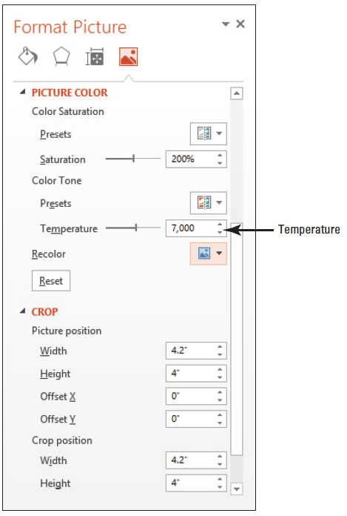
Step by Step: Apply Color Adjustments
In the Picture Color section under Color Tone, set the Temperature value to 7,000 by typing 7,000 in the Temperature text box (see the figure at right).
Close the task pane.
SAVE the presentation.
PAUSE. LEAVE the presentation open to use in the next exercise.

Slide 41
Step by Step: Add Picture Effects to an Image
USE the Exhibits Final Version 2 presentation that is still open from the previous exercise.
Go to slide 4 and click the picture to select it.
Click the Picture Tools Format tab.
Click the Picture Effects button in the Picture Styles group, point to Preset in the drop-down menu that appears, and click Preset 2. A preset formatting effect is applied.
Click the Picture Effects button, point to Bevel, and click Art Deco. A different bevel is applied.
Click the Picture Effects button, point to Glow, and click Periwinkle, 8 point glow, Accent color 5. An 8-point periwinkle blue glow is placed around the picture.

Slide 42

Step by Step: Add Picture Effects to an Image
Click away from the picture to deselect it so you can see it more clearly. The slide should look like the figure at right.
SAVE the presentation.
PAUSE. LEAVE the presentation open to use in the next exercise.

Slide 43
Step by Step: Add Artistic Effects to an Image
USE the Exhibits Final Version 2 presentation that is still open from the previous exercise.
Go to slide 7 and click the picture to select it.
Click the Picture Tools Format tab.
Click Artistic Effects in the Adjust group to open the Artistic Effects gallery, and point to several different settings in the gallery. Observe their effect on the image behind the open palette.

Slide 44
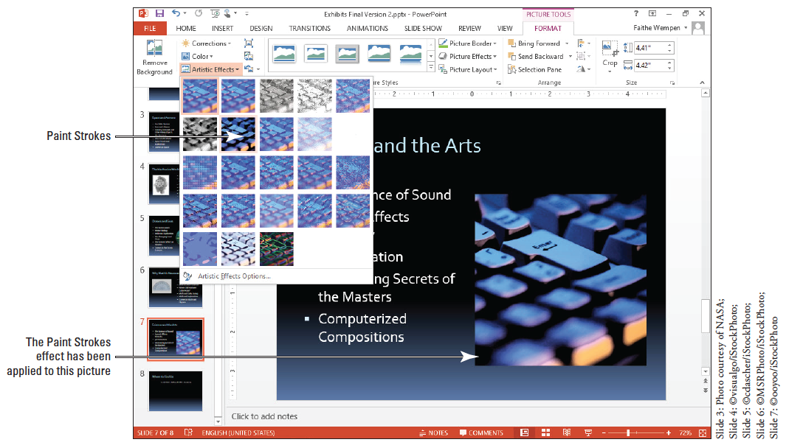
Step by Step: Add Artistic Effects to an Image
Click Paint Strokes. (It is the second one in the second row.) Your slide should look similar to the figure below.
SAVE the presentation.
PAUSE. LEAVE the presentation open to use in the next exercise.

Slide 45
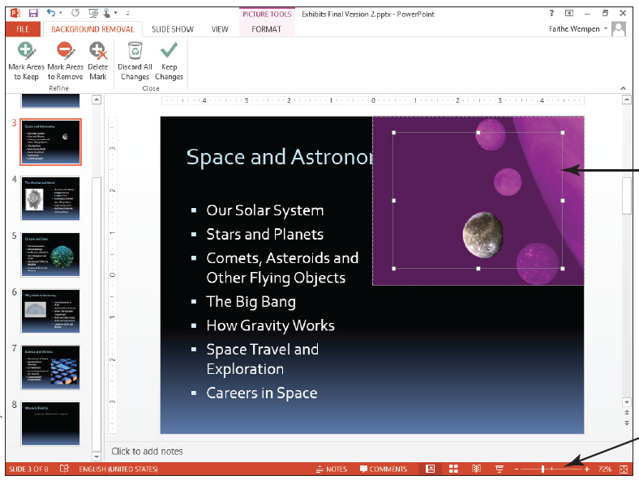
Step by Step: Remove an Image Background
USE the Exhibits Final Version 2 presentation that is still open from the previous exercise.
Go to slide 3 and click the picture to select it.
On the Picture Tools Format tab, click Remove Background. The Background Removal tab appears on the Ribbon, and the picture turns purple except for one planet (see the figure at right). The purple areas are the parts that will be removed.

Slide 46
Step by Step: Remove an Image Background
Zoom in to 100% zoom using the Zoom slider in the bottom right corner of the PowerPoint window, and adjust the display so you can see the photo clearly.
Notice that inside the picture is a rectangular border with selection handles. Only content within this rectangle will be kept. Drag the corner selection handles of that rectangle so that the entire picture is inside that area.
On the Background Removal tab, click Mark Areas to Keep.
Click and drag to draw across one of the planets. If the entire planet does not turn back to its original color with a single click, continue clicking different parts of it until the entire planet appears in its original color. Zoom in further if needed to see what you are doing.
Notes:
Troubleshooting: If you make a mistake and click too much, and the whole background turns black, press Ctrl+Z to undo your last action and try again.

Slide 47
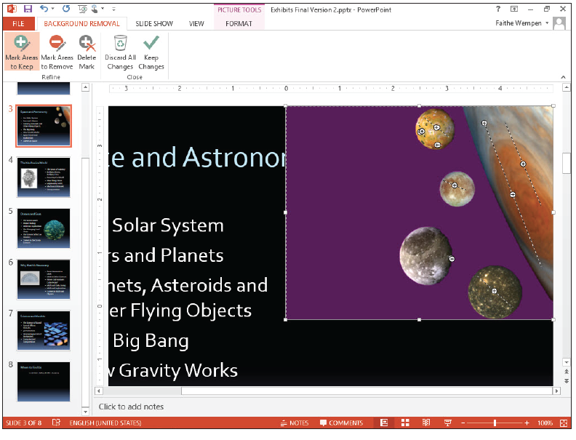
Step by Step: Remove an Image Background
Repeat step 6 until only the background is purple, and all planets appear in their original colors (see figure).
Click Keep Changes in the Close group of the Background Removal tab to finalize the back- ground removal. Now that the background is removed, the slide title is no longer partly obscured.

Slide 48
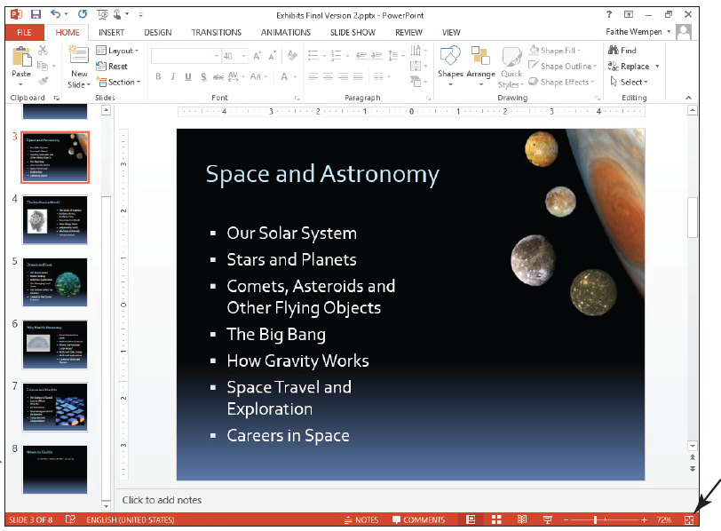
Step by Step: Remove an Image Background
Click away from the image to deselect it.
Click Fit Slide to Current Window in the status bar at the bottom of the Power- Point window to reset the slide’s zoom (see figure).
SAVE the presentation.
PAUSE. LEAVE the presentation open to use in the next exercise.

Slide 49
Step by Step: Compress the Images in a Presentation
USE the Exhibits Final Version 2 presentation that is still open from the previous exercise.
Click the File tab, and make a note of the file size under the Properties heading. Then press Esc to return to the presentation.
Click any picture in the presentation to select it, and then click the Picture Tools Format tab.
Click Compress Pictures in the Adjust group. The Compress Pictures dialog box opens.
Click the Email (96 ppi) option button.

Slide 50
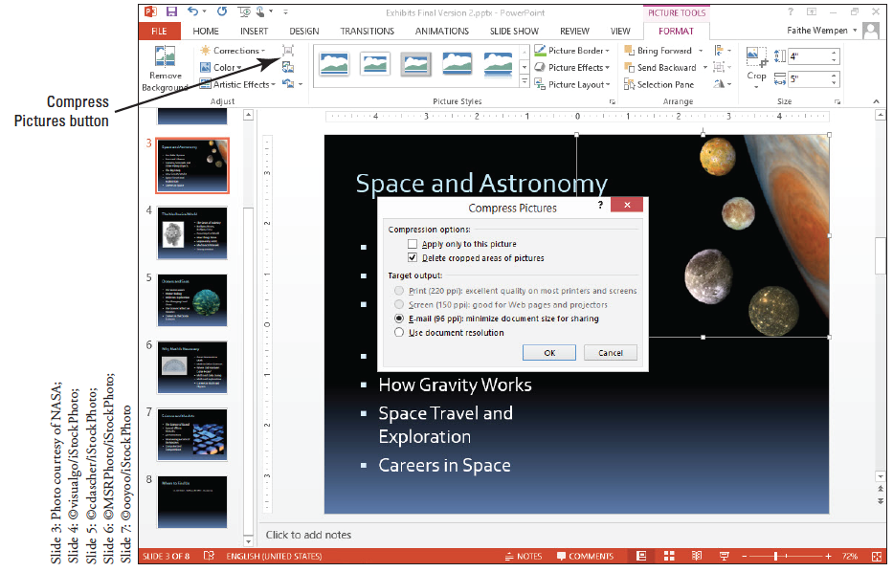
Step by Step: Compress the Images in a Presentation
Clear the Apply only to this picture check box (see the figure below). If you wanted to compress only the selected picture, you would leave this option checked.
Click OK.

Slide 51
Step by Step: Compress the Images in a Presentation
SAVE the presentation. PowerPoint applies the compression settings you selected.
Repeat step 1 to recheck the presentation’s file size.
PAUSE. LEAVE the presentation open to use in the next exercise.
ply the same setting to all pictures in the presentation.

Slide 52
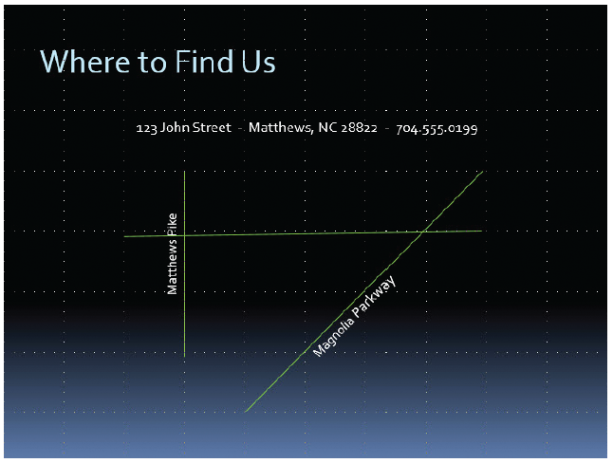
Step by Step: Draw Lines
USE the Exhibits Final Version 2 presentation that is still open from the previous exercise, and save it as Exhibits Final Version 3.
Go to slide 8. You will create a map on this slide to show potential visitors how to get to the museum. As you work, refer to the figure for position of objects.

Slide 53
Step by Step: Draw Lines
Click the View tab, and then click Gridlines to turn gridlines on.
Create the first street for the map as follows:
a. Click the Home tab, and then click the Shapes button to display the gallery of drawing shapes.
b. Click Line in the Line group. The pointer takes the shape of a crosshair.
c. Locate the intersection of vertical and horizontal gridlines below the letter n in John, click at the intersection, and drag downward to create a vertical line three “blocks” long.
Notes:
Take Note: You can also access the Shapes gallery on the Drawing Tools Format tab.

Slide 54
Step by Step: Draw Lines
Add the street name as follows:
a. Click Text Box on the Insert tab, click anywhere on the slide, and type the text Matthews Pike.
b. Click the outer border of the text box to select all content within the text box, and change the font size to 16.
c. On the Drawing Tools Format tab, click Rotate, and click Rotate Left 90º.
d. Move the rotated street name just to the left of the vertical line (see the figure on slide 72).
Select the Line tool again, hold down Shift, and draw the diagonal line shown in the figure on slide 72.
Notes:
Take Note: Holding down the Shift key constrains the line to be exactly 45 degrees or exactly vertical or horizontal as you drag.

Slide 55
Step by Step: Draw Lines
Select the Line tool again and draw the horizontal line shown in the figure on slide 72.
Add the street name for the diagonal street as follows:
a. Insert a text box anywhere on the slide, and type Magnolia Parkway.
b. Change the font size to 16.
c. With the text box still selected, click Arrange, point to Rotate, and click More Rotation Options…. The Size and Position dialog box opens.
d. Type –45 in the Rotation box, and then click Close.

Slide 56
Step by Step: Draw Lines
e. Move the rotated text box to the right of the diagonal line (see the figure on slide 72).
On the View tab, clear the Gridlines check box to turn off gridlines again.
SAVE the presentation.
PAUSE. LEAVE the presentation open to use in the next exercise.

Slide 57
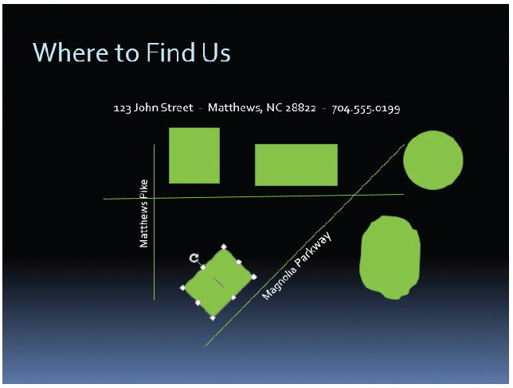
Step by Step: Draw and Resize Shapes
USE the Exhibits Final Version 3 presentation that is still open from the previous exercise. As you work, refer to slide 72 to help you position and size objects.
On the Home tab, click Shapes, and then click the Rectangle tool. Hold down the mouse button, and drag to create the taller rectangle above the horizontal line (see the figure at right).

Slide 58
Drawing and Resizing Shapes
With the shape still selected, click the Drawing Tools Format tab. Note the measurements in the Size group. If necessary, adjust the size so the shape is 1 inch high by 0.9 inches wide.
Select the Rectangle tool again and use it to create the wider rectangle shown in the figure on slide 80. This shape should be 0.7 inch high by 1.2 inches wide.
Select the Oval tool, hold down Shift, and draw the circle shownin the figure on slide 80. This shape should be 1 inch high and wide.
Click the Rectangle tool and create a rectangle 0.7 inches high by 1 inch wide near the lower end of the diagonal street.

Slide 59
Drawing and Resizing Shapes
Click the shape’s rotation handle and drag to the right to rotate the shape so its right side is parallel to the diagonal road ().
Click the Freeform tool in the Lines section in the Shapes gallery. Near the bottom of the slide (so you can easily see the line you are drawing), draw an irregular oval shape to represent a lake. The shape should be about 1.4 inches high and 1.5 inches wide.
Notes:
Troubleshooting: When using the Freeform tool, if you return to the exact point at which you started drawing, PowerPoint will automatically close and fill the shape with color. If your shape does not fill, double-click to end it, click Undo, and start again.

Slide 60
Drawing and Resizing Shapes
Drag the lake shape to the right of the diagonal line (see the figure on slide 80).
SAVE the presentation.
PAUSE. LEAVE the presentation open to use in the next exercise.

Slide 61
Step by Step: Add Text to Shapes
USE the Exhibits Final Version 3 presentation that is still open from the previous exercise.
While still on slide 8, click in the taller rectangle above the horizontal street, and then type West Bank Center.
Click in the wide rectangle shape, and then type Baldwin Museum.
Click in the circle shape, and then type Miller Arena.
Click in the rotated rectangle, and then type Holmes College. Note that the text is rotated as well.
Click in the freeform lake object, and then type Magnolia Lake.

Slide 62
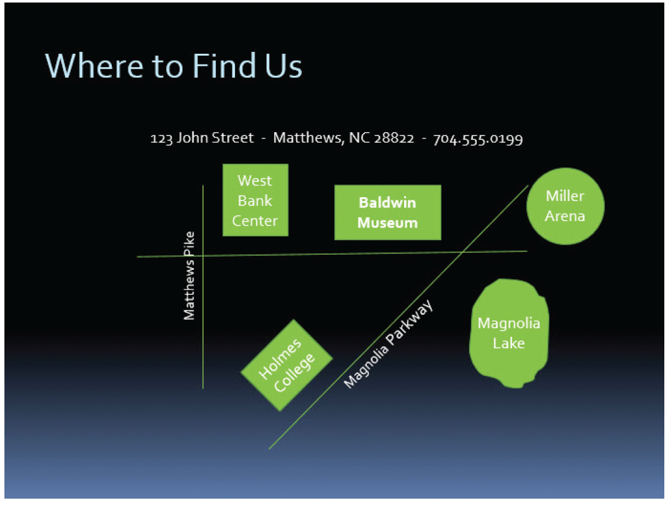
Step by Step: Add Text to Shapes
Adjust the widths of any of the shapes as needed so that the text fits in them.
Drag over the Baldwin Museum text to select it, and then click the Bold button to boldface the text. Your map should look similar to the figure at right.
SAVE the presentation.
PAUSE. LEAVE the presentation open to use in the next exercise.
Notes:
Take Note: To adjust the way text appears in a shape, right-click the shape, click Format Shape, click Text Options, click the Textbox icon, and access the Text Box settings. For example, you can align the text vertically and horizontally within the shape.

Slide 63
Step by Step: Format Shapes
USE the Exhibits Final Version 3 presentation that is still open from the previous exercise.
On the drawing on slide 8, format the Matthews Pike line and label as follows:
a. Click the vertical line that represents Matthews Pike.
b. On the Drawing Tools Format tab, click the Shape Outline button, and then click the Gold, Accent 3 theme color.
c. Click the Shape Outline button again, point to Weight, and click 6 pt.
d. Click the outside border of the Matthews Pike text box to select all content in the text box, and on the Home tab, click Font Color, and click Black, Background 1.
Notes:
Take Note: You can use the Shape Outline button in the Drawing group on the Home tab or in the Shape Styles group on the Drawing Tools Format tab.

Slide 64
Step by Step: Format Shapes
e. With the text box still selected, click the Shape Fill button, and then click White, Text 1.
f. Drag the text box to the left slightly if needed so that it does not overlap the vertical line.
Click the horizontal line and repeat steps 1a-1c to format the line with the White, Text 1, darker 35% theme color and 6 pt. weight. (Do not worry if the street overlaps over the Matthews Pike text box. You will learn to fix this problem in a later exercise.)
Click the diagonal Magnolia Parkway line, click the Shape Outline button, point to Weight, and click 6 pt.

Slide 65
Step by Step: Format Shapes
Format the Magnolia Parkway text box following steps 1d and 1e to change text to black and the fill to white.
Format the other shapes as follows:
a. Click the West Bank Center shape above the horizontal street, hold down Shift, and click each additional filled shape until all are selected. (Do not click any of the lines or the street name text boxes.)
b. Click Shape Outline, and then click No Outline. You have removed outlines from the selected shapes.
c. Click the More button in the Shape Styles group, and click the Intense Effect - Black, Dark 1 effect (the first style in the last row).

Slide 66
Step by Step: Format Shapes
d. Click away from the shapes to deselect them all, and then click the Baldwin Museum shape to select it.
e. On the Drawing Tools Format tab, click Shape Fill, and click Pink, Accent 2, Darker 25%.
f. Click Shape Effects, point to Preset, and click Preset 1.
Apply a texture to the Magnolia Lake shape by doing the following:
a. Click the Magnolia Lake shape.
b. On the Drawing Tools Format tab, click Shape Fill, point to Texture, and click the Water Droplets texture.
c. Click the Text Fill button's arrow to open its palette and click Black, Background 1.

Slide 67
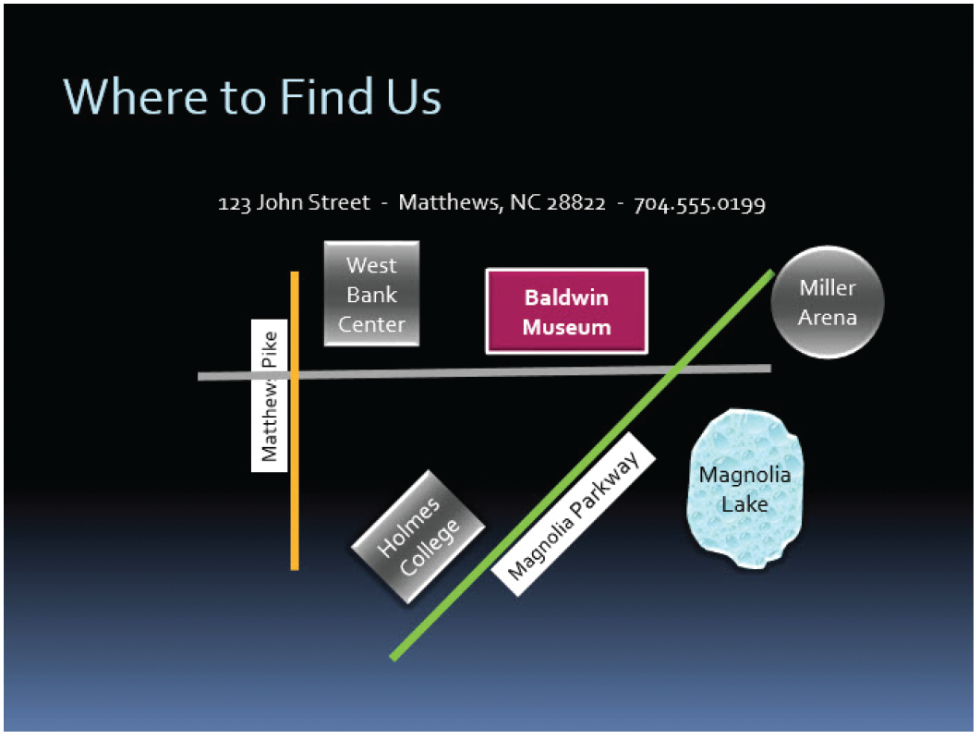
Step by Step: Format Shapes
Click away from the Magnolia Lake shape to deselect it. Your map should look similar to the figure at right.
SAVE the presentation.
PAUSE. LEAVE the presentation open to use in the next exercise.

Slide 68
Step by Step: Create a Custom Shape
USE the Exhibits Final Version 3 presentation that is still open from the previous exercise.
Go to slide 1, and on the Insert tab, click Shapes, and then click the 8-point Star in the Stars and Banners section of the shape list.
Hold down the Shift key and drag on the slide, above the text, to draw a star that is approximately 2” in both height and width.

Slide 69

Step by Step: Create a Custom Shape
On the Insert tab, click Shapes, and then click the crescent moon shape. Drag to draw it over the 8-point star (see the figure at right).
Click the 8-point star, |hold down Shift, and click the crescent moon shape. Both are selected.

Slide 70
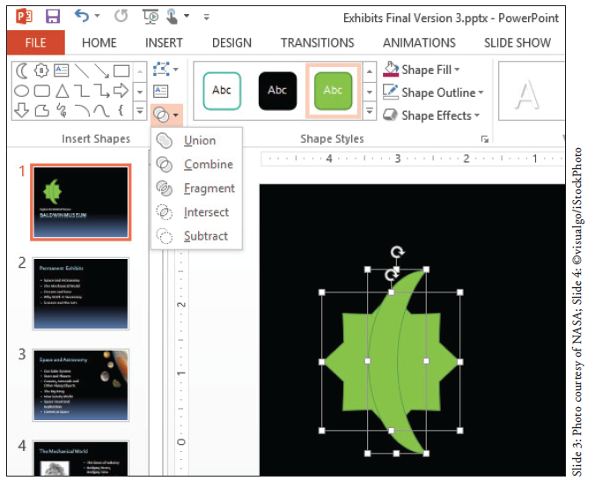
Step by Step: Create a Custom Shape
On the Drawing Tools Format tab, click the Merge Shapes button. A menu opens (see the figure at right).
Point to each of the menu options to see that effect previewed son the shape.

Slide 71

Step by Step: Create a Custom Shape
Click Combine. The two shapes are combined such that the area where they overlapped is removed (see the figure at right).
Select the shape, and on the Drawing Tools Format tab, click Shape Fill and click Light Blue, Text 2, Darker 90%.

Slide 72
Step by Step: Create a Custom Shape
Click Shape Outline and click No Outline.
SAVE the presentation.
PAUSE. LEAVE the presentation open to use in the next exercise.

Slide 73
Step by Step: Set Object Order
USE the Exhibits Final Version 3 presentation that is still open from the previous exercise.
Go to slide 1, and draw a new rectangle that covers the logo.
a. On the Home tab, click Shapes, and click Rectangle.
b. Drag to draw a square over the existing logo. Hold down Shift to constrain the rectangle to make it a square.
c. On the Drawing Tools Format tab, adjust the Height and Width of the rectangle so that its height and width are equal and just large enough to cover the logo.

Slide 74
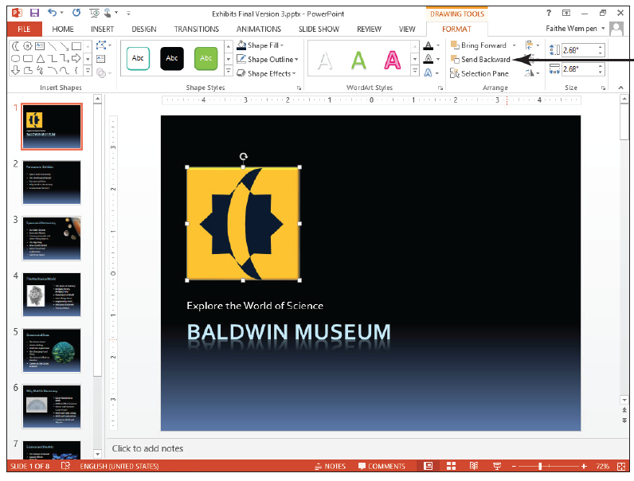
Step by Step: Set Object Order
d. Click Shape Fill, and click Gold, Accent 3.
e. Click Shape Effects, point to Bevel, and click Circle.
On the Drawing Tools Format tab, click Send Backward (see figure). The rectangle moves behind the star/moon shapes. Do not worry if they are not neatly aligned with one another; you will learn how to align them later in this lesson.

Slide 75
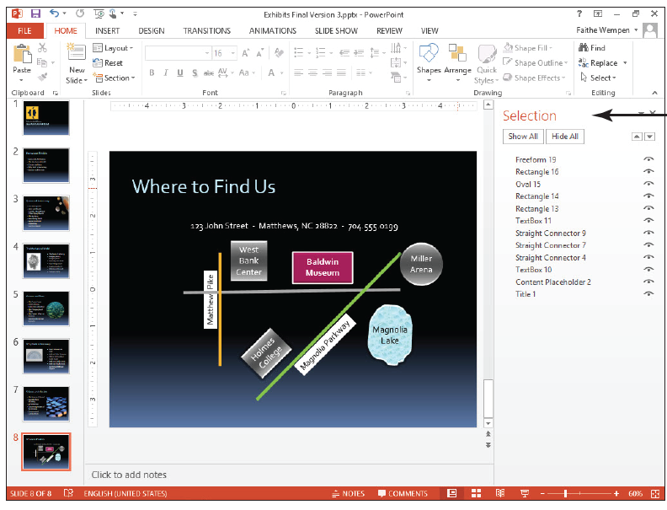
Step by Step: Set Object Order
Go to slide 8. On the Home tab, click the Arrange button, and then click Selection Pane. The Selection task pane opens (see figure), showing the current slide content in the order in which it was created, from bottom to top. This order is determined by the order in which the objects were added to the slide.
Notes:
Take Note: The Arrange tools are available on both the Home tab and the Picture Tools Format tab.
Troubleshooting: Do not be concerned if the list in your Selection pane does not exactly match the one shown in Figure 8-35. The order and numbering of objects in the pane can be affected by many actions.

Slide 76
Step by Step: Set Object Order
Click the gold Matthews Pike street line in the map to see how it is identified in the Selection pane—it will have a name such as Straight Connector 7 (or some other number). Then click the horizontal street line to see its name.
Click the Matthew Pike street line again to select it. If that line is not already on top of the horizontal street line, click the Bring Forward arrow (the up arrow button) in the Selection task pane until it is.
Click the Matthews Pike text box and click the Bring Forward arrow until the text box is on top of the horizontal gray line in the map if was not already so.
Click the Magnolia Parkway street line and click the Bring Forward arrow until the diagonal street is above the horizontal street in the map if it is not already so. Then close the task pane.
Notes:
Another Way: You can also use the Bring Forward button on the Drawing Tools Format tab in step 6.

Slide 77
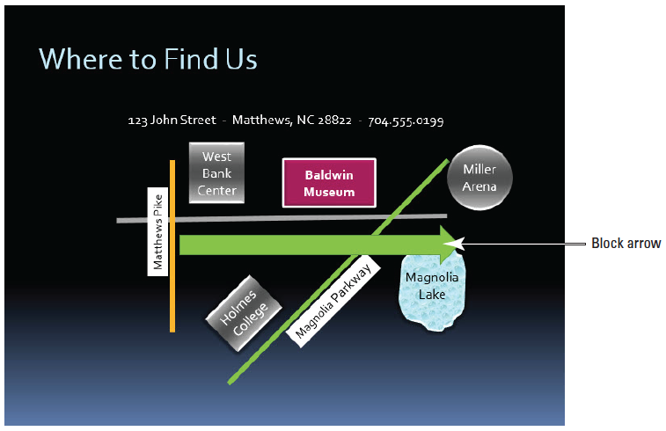
Step by Step: Set Object Order
You have one more shape to add to the map: an arrow that labels the horizontal street as John Street and indicates that the street is one way. Click Shapes on the Home tab, click Right Arrow in the Block Arrows group, and draw a block arrow (see the figure bove). The arrow should be about 0.7 inches high and 5 inches wide.

Slide 78
Step by Step: Set Object Order
In the arrow, key John Street - ONE WAY.
On the Home tab, click Align Left to make the text align on the left side of the arrow.
Using the Shape Fill button, apply the Green, Accent 1, Darker 50% color to the arrow.
Right-click a blank area of the block arrow (to the left of the words John Street, for example), point to Send to Back, and click Send to Back. The arrow moves behind all lines and shapes.

Slide 79
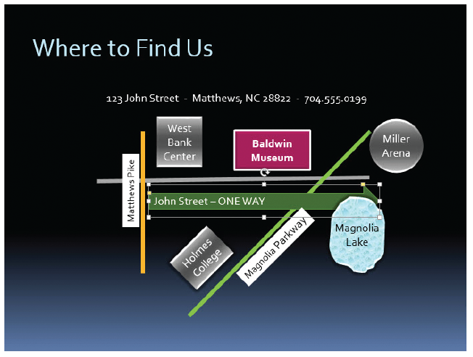
Step by Step: Set Object Order
Click the Bring Forward button on the Drawing Tools Format tab until the arrow is in front of the diagonal line representing Magnolia Parkway but the behind Magnolia Lake shape. The figure at right shows the completed map.
SAVE the presentation.
PAUSE. LEAVE the presentation open to use in the next exercise.

Slide 80
Step by Step: Align Objects with Each Other
USE the Exhibits Final Version 3 presentation that is still open from the previous exercise.
On slide 8, click the West Bank Center shape, hold down Shift, and click the Baldwin Museum shape and the Miller Arena shape. These landmarks are all different distances from the John Street horizontal line but can be aligned for a neater appearance.

Slide 81
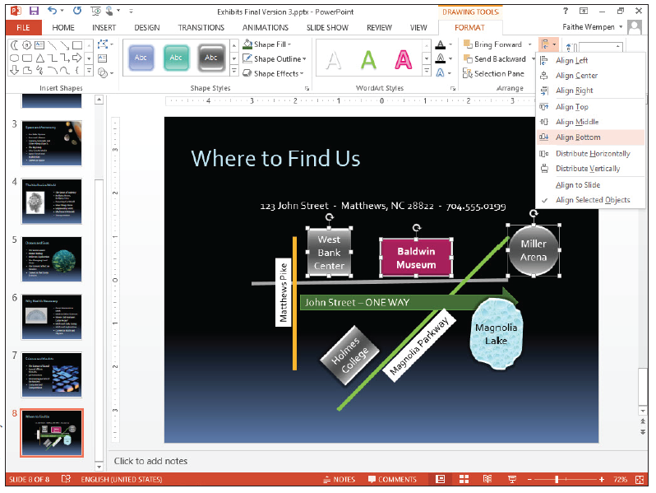
Step by Step: Align Objects with Each Other
Click the Drawing Tools Format tab if necessary, and in the Arrange group, click Align Objects, and click Align Bottom (right). The shapes are now aligned at the bottom so they are the same distance from the horizontal line.
SAVE the presentation.
PAUSE. LEAVE the presentation open to use in the next exercise.

Slide 82
Step by Step: Group Objects
USE the Exhibits Final Version 3 presentation that is still open from the previous exercise.
While still on slide 8, click above and to the left of the map (but below the line of text), and then hold down the left mouse button and drag downward and to the right until you have included the entire map in the selected area. This is called lassoing the shapes.
Release the mouse button. All the shapes within the selection lasso are selected.

Slide 83
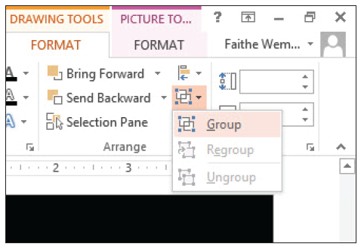
Step by Step: Group Objects
Click the Drawing Tools Format tab. Click the Group Objects button, and then click Group (see figure). All objects are surrounded by a single selection border.
SAVE the presentation and CLOSE the file.
PAUSE. LEAVE PowerPoint open to use in the next exercise.

Slide 84
Step by Step: Create a Photo Album Presentation
GET READY. Before you begin these steps, start PowerPoint. You do not have to start a new presentation, because you will create one as part of the exercise.
On the Insert tab, click Photo Album. The Photo Album dialog box opens.
Click the File/Disk… button. The Insert New Pictures dialog box opens.
Navigate to the location where the data files for this lesson are stored, and click Astronomy.jpg.
Notes:
Take Note: Even though you are using the Insert tab, you are not actually inserting the photo album into the existing presentation; instead, you are creating a brand-new presentation file.

Slide 85
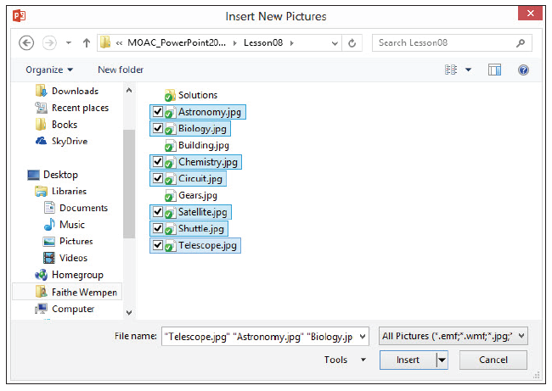
Step by Step: Create a Photo Album Presentation
Hold down the Ctrl key and click the following files: Biology.jpg, Chemistry.jpg, Circuit.jpg, Satellite.jpg, Shuttle.jpg, and Telescope.jpg (see figure).

Slide 86
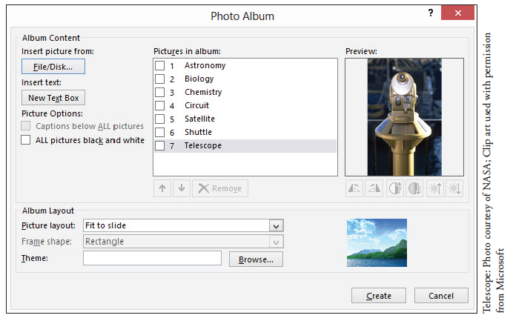
Step by Step: Create a Photo Album Presentation
Click Insert. The Photo Album dialog box reappears, with all the selected pictures listed (see the figure below).

Slide 87
Step by Step: Create a Photo Album Presentation
Click the checkbox for the Circuit.jpg graphic on the list, and then click the Move Up arrow three times to move it to the first position in the list. Then clear its check box.
Click New Text Box. A text box entry is inserted on the list of graphics between Circuit.jpg and Astronomy.jpg.
Click the check box for the Shuttle.jpg graphic, and then click the Rotate Right button to rotate it 90 degrees in a clockwise direction. Then clear its check box.
Click the check box for the Satellite.jpg graphic, and then click the Increase Brightness button twice to brighten the image. Then clear its check box.
Click the check box for the Biology.jpg graphic, and then click the Increase Contrast button to increase the image contrast. Then clear its check box.
Open the Picture Layout: drop-down list and click 1 Picture.

Slide 88
Step by Step: Create a Photo Album Presentation
Open the Frame Shape: drop-down list and click Rounded Rectangle.
Click to mark the Captions below ALL pictures check box.
Click Create. The presentation is created.
Browse through the presentation to see what has been created. Notice that each picture has a caption under it that shows the file name (minus the file extension). Notice that the text box has been placed on its own separate slide, just as if it were a picture.
On the Insert tab, click the arrow next to the Photo Album button, and on the menu that appears, click Edit Photo Album…. The Edit Photo Album dialog box opens. It is similar to the Photo Album dialog box in the figure on slide 124.

Slide 89
Step by Step: Create a Photo Album Presentation
Open the Picture Layout: drop-down list and click 2 Pictures.
Click the Browse…con button next to Themes. Click the Ion theme and click Select.
Click the ALL pictures black and white check box.
Click Update. The dialog box closes and the changes are reflected in the presentation.
Browse through the presentation to see what has been changed.
SAVE the presentation as Photo Album Final.
EXIT PowerPoint.

Slide 90
Skill Summary

